Slide 1
School family
Mittelschule Wörth a. d. Donau

Slide 2
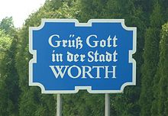
Outline:
Welcome
Maintenance man
Cooking team
Erasmus + team members
Class 5G2, 7G and 10MG
Secretary
Deputy headmaster
Headmaster

Slide 3
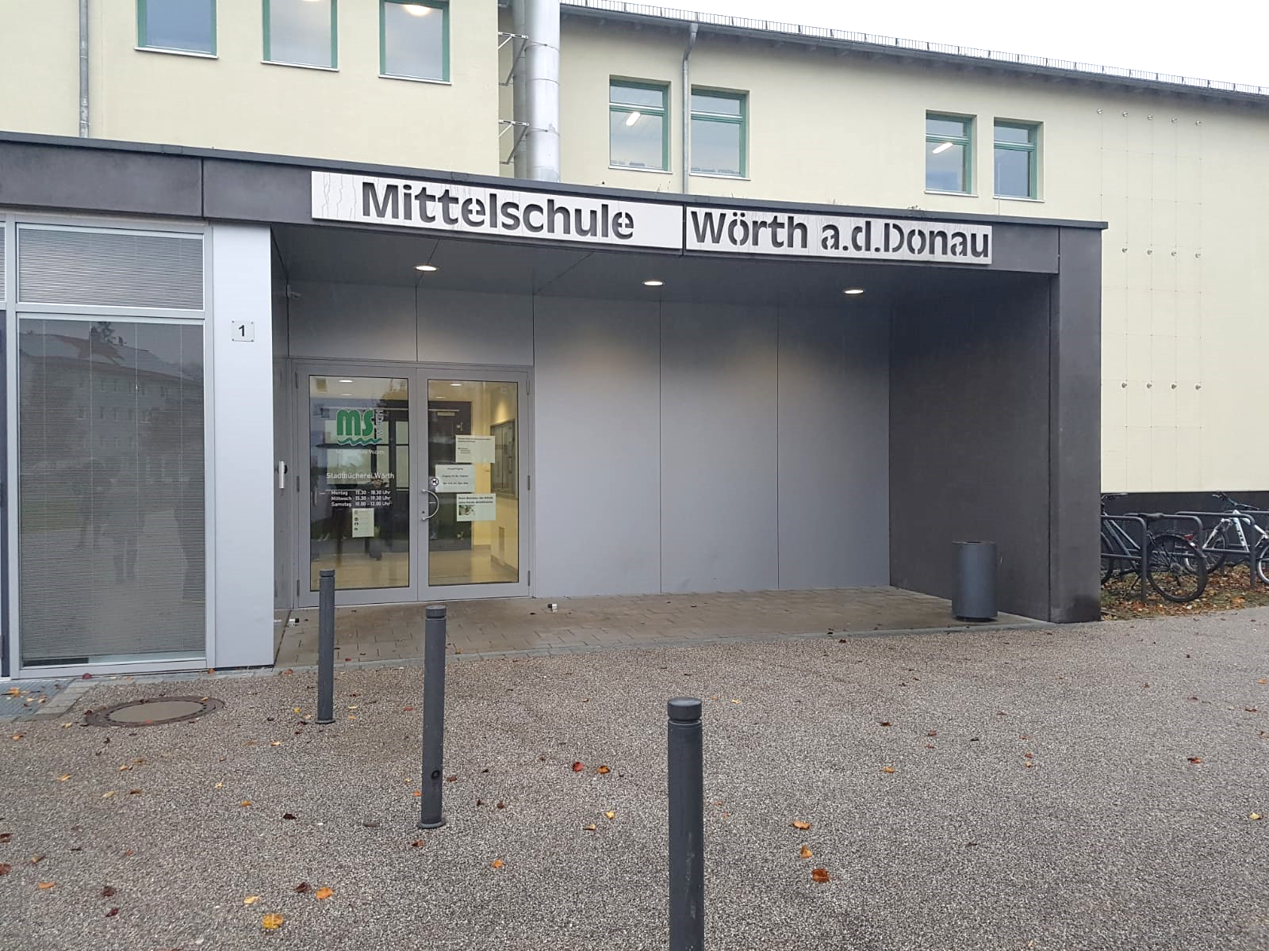
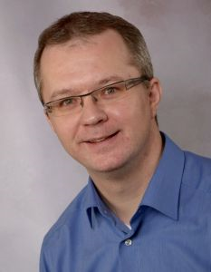
Welcome
As deputy headmaster of the middleschool Wörth/Donau, I send greetings to our partner schools in Europe. It is a pity that the students and teachers involved can‘t meet. Right now special situations need special rules. We are happy to present our school to you - in a very special way. In this presentation you will see some pictures to get an excellent impression of our school. We hope you like it and you can imagine what it is like at our school. We are already looking forward to learn something about your schools. Of course we are very keen on meeting you after these bad times. We wish you all the best and please stay healthy.

Slide 4
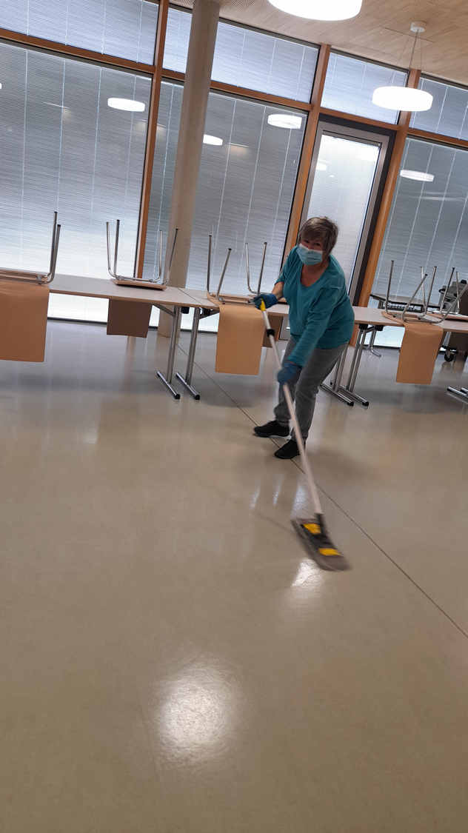
Cleaner
There are seven cleaning wives working at our school. Their job is to bring the school building to a glossy format. They clean and tidy the different classrooms. In addition they disinfect the whole school during this difficult time in order to offer protection to the students.

Slide 5
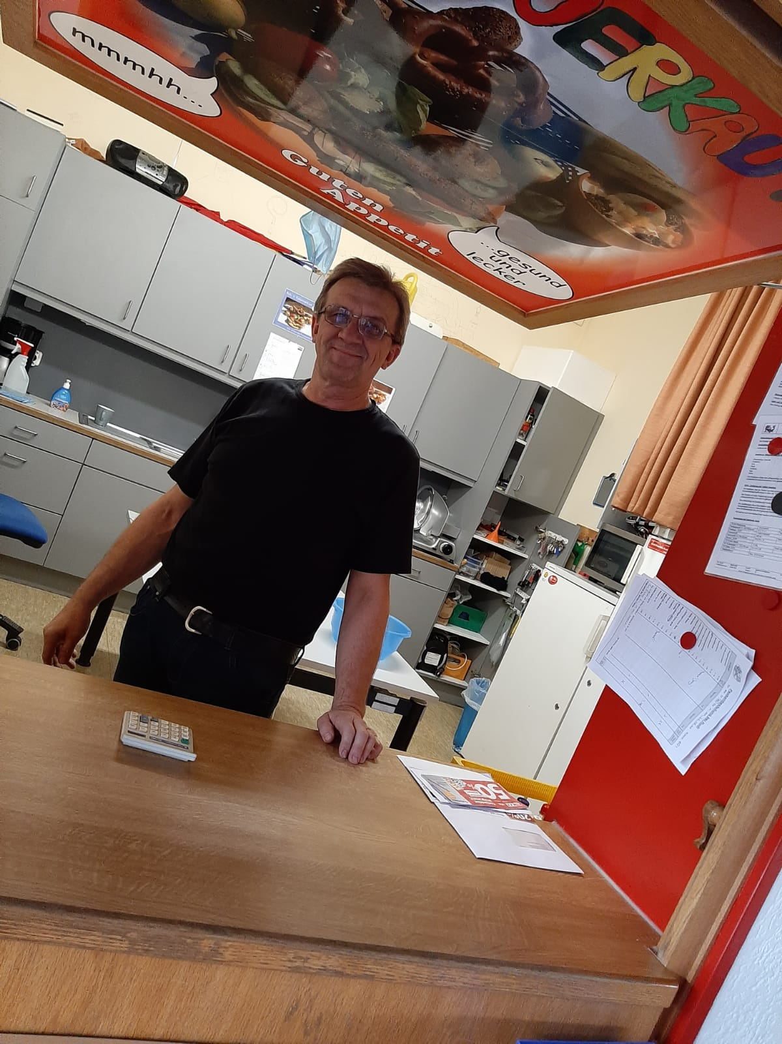
Maintenance man
Rudi, our maintenance man, takes care of everything. He has no specific area of ​​work. He sells home-made food during the breaks, looks after the interior of the school, repairs broken objects, and also keeps the school yard clean.

Slide 6
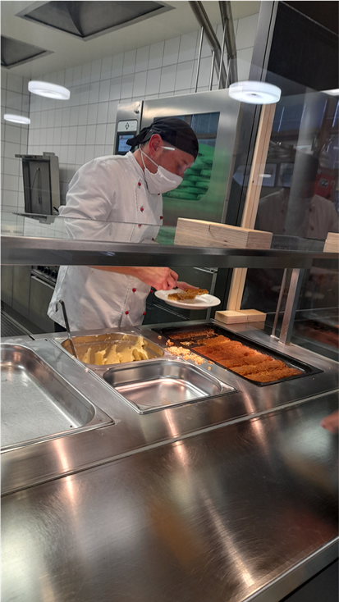
Cooking team
In this picture you can see the cook of the Middle School Wörth. Every day he and his team prepares a delicious meal for the students. Every day there are 2 dishes to choose from: a meat and a vegetarian dish, and there is also a large salad bar (But not in corona time).

Slide 7
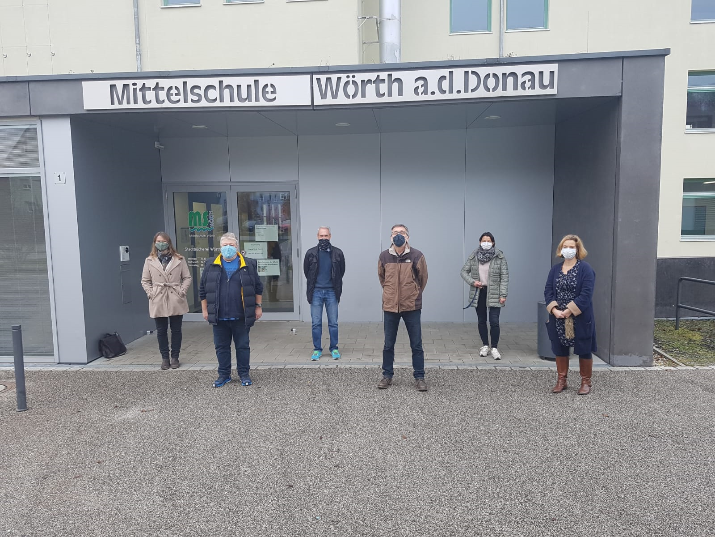
Erasmus + teammember
Andrea Thaler
Klaus Zierer
Peter Wunsch
Franz Schifferl
Sabine Bäumel
Karin Zelenka

Slide 8
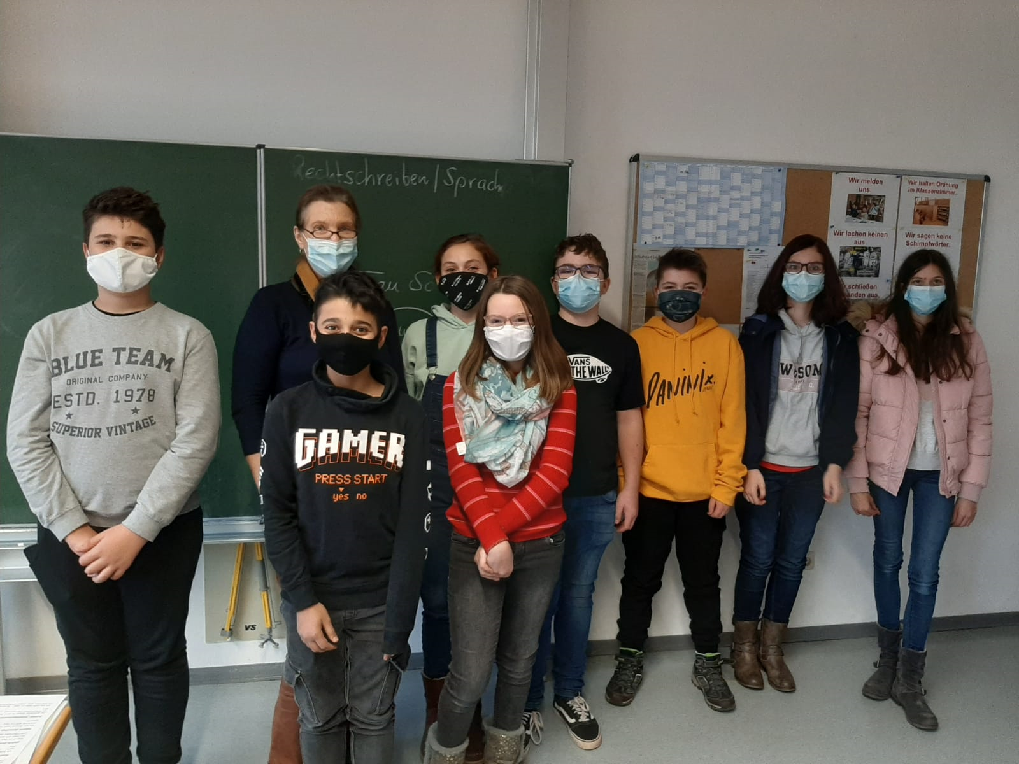
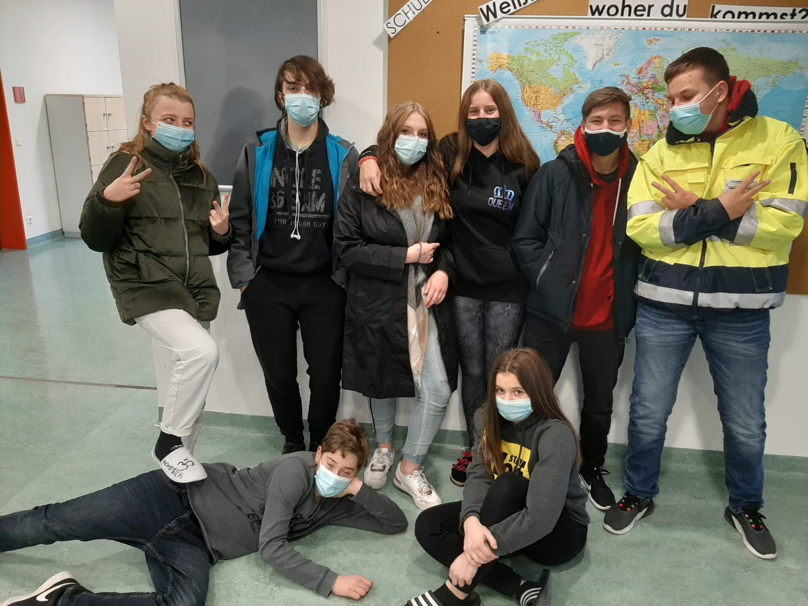
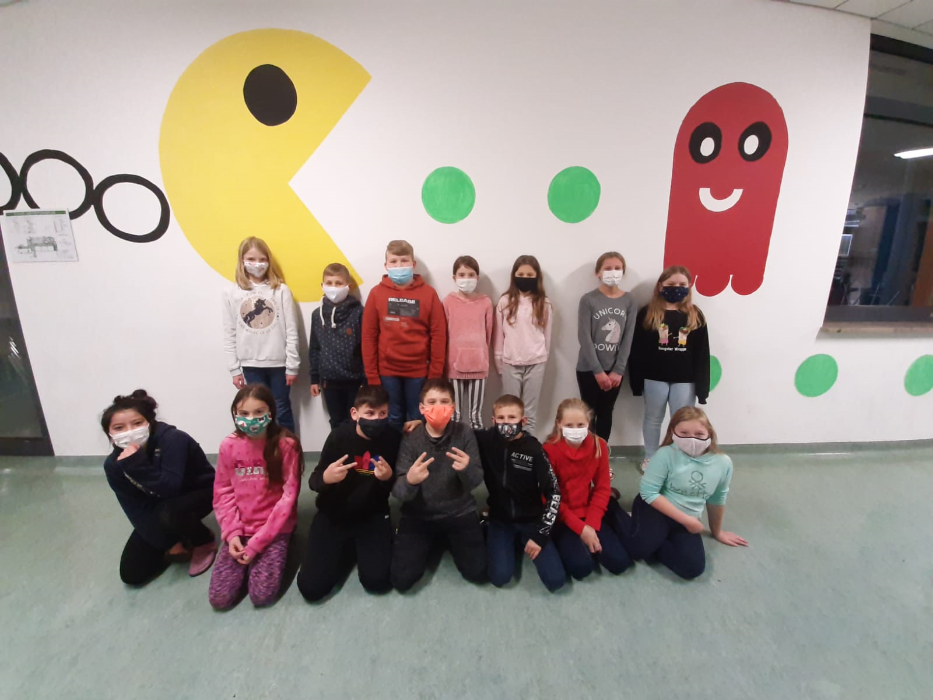
Class 5G2, 7G and 10MG
Class 7G
Class 10MG
Class 5G2

Slide 9
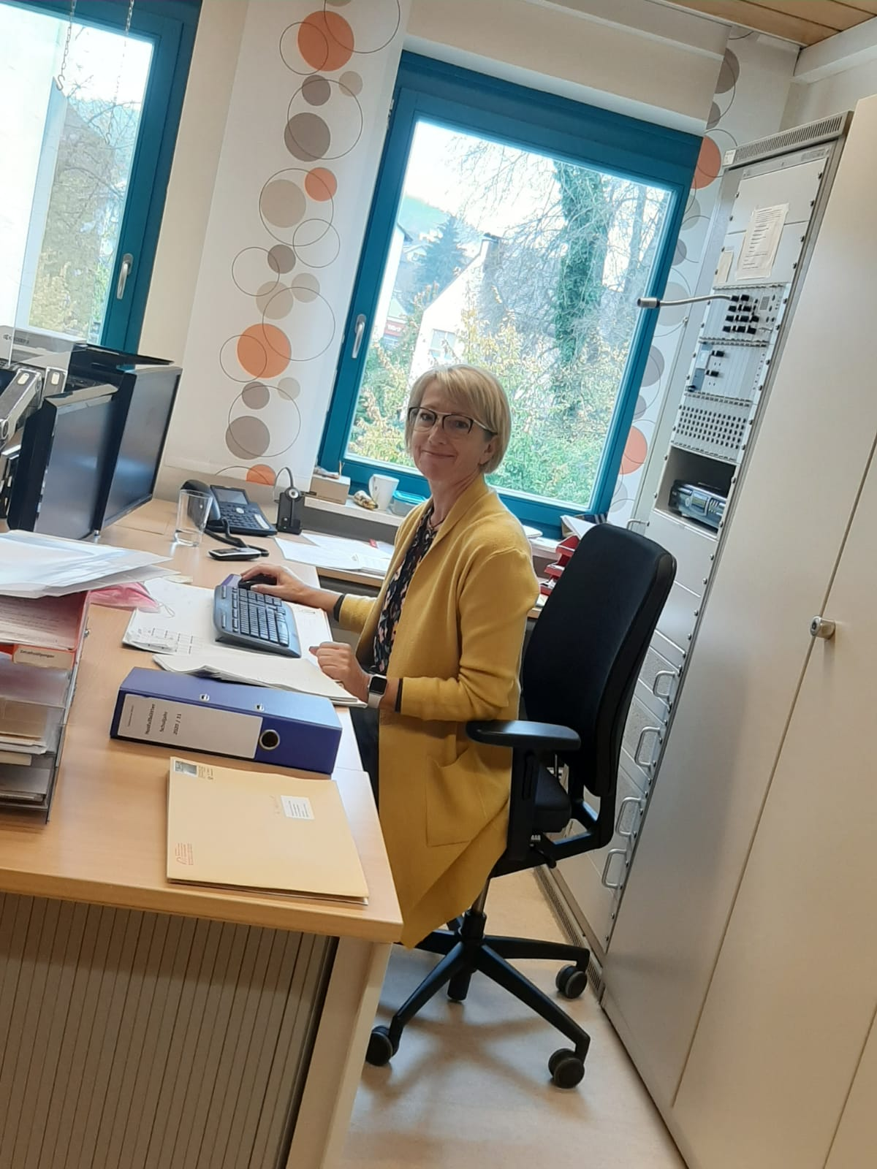
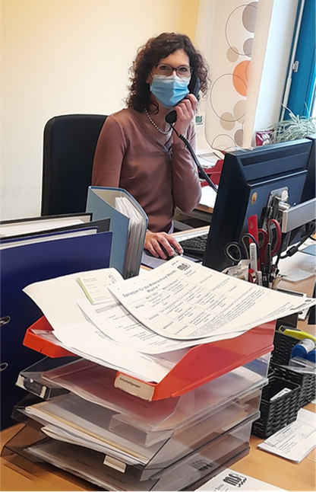
Secretaries
They organize the school process. The two ladies also deal with school events, letters from parents and general school activities. They take care of the students’ who don’t feel well and send them home if necessary. So one of their jobs is to pay attention to the school's health system.

Slide 10
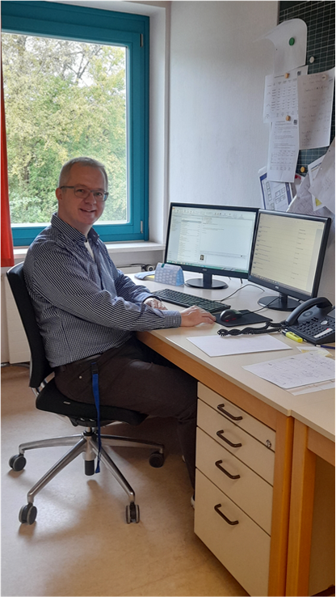
Deputy headmaster
Our deputy headmaster is named Mr. Vatter. He mainly handles the organizational matters, and he also teaches in class. He is the contact person for problems and concerns for anybody in school.
Notes:
10

Slide 11
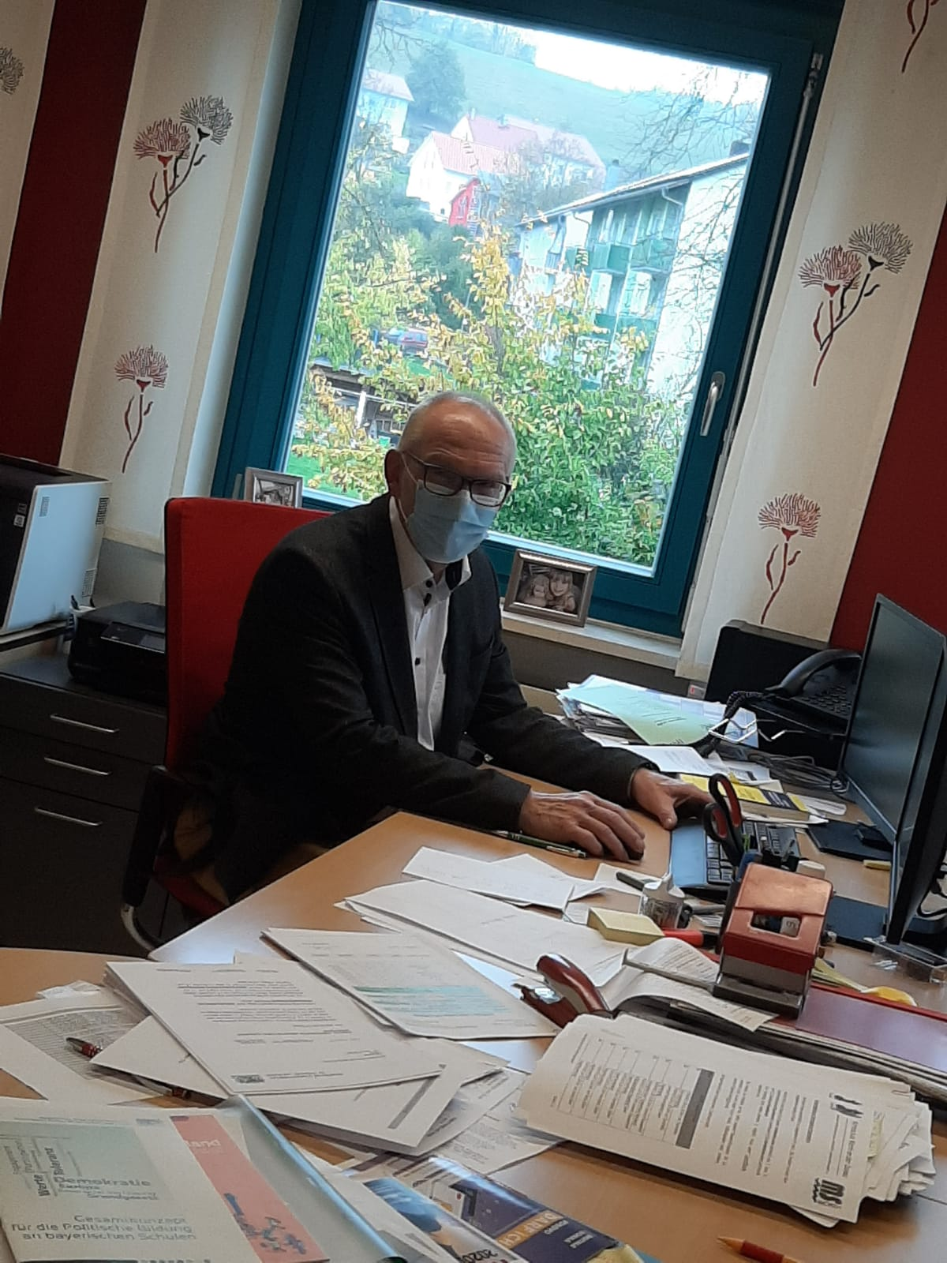
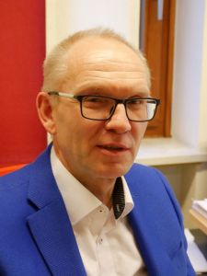
Headmaster
Here you can see our headmaster, Mr. Voggenreiter. He represents our school to the public. He overviews everything that has to do with our school, carries out projects and helds speeches for the school. He is the superviser.

