Slide 1
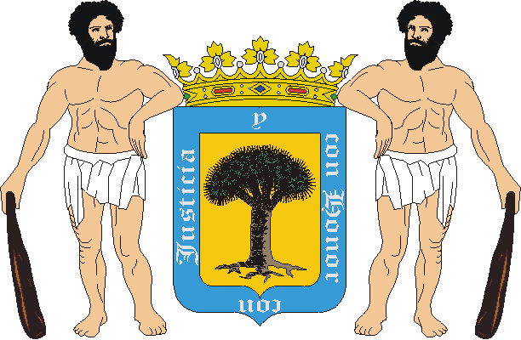
My town, Valsequillo

Slide 2
In our town we are more than 9000 people. We have lots of activities, and we love it!!

Slide 3
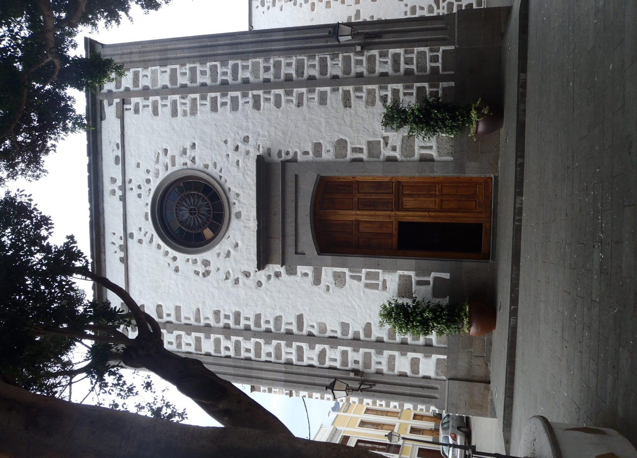
Church
This is the Church of Valsequillo, it is called San Miguel Arcángel. Here we celebrate Christenings, weddings and communions. It’s small and as you can see it is white with stones. It is very beautiful and cozy .

Slide 4
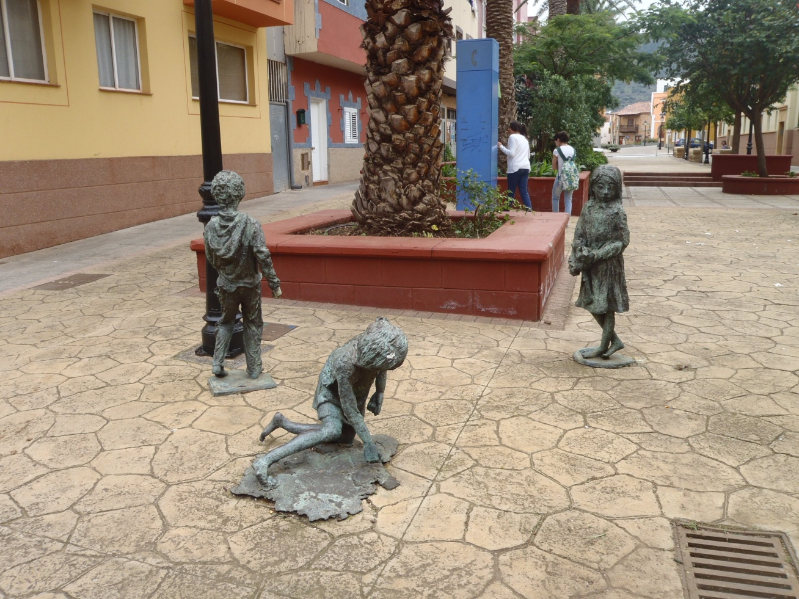
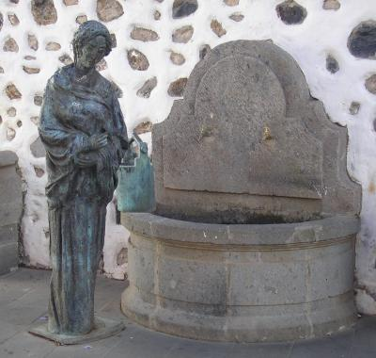
Our friends!
When you go to the village, you will see these sculptures. We love them, they are our friends. Since we remember they have always been there.

Slide 5
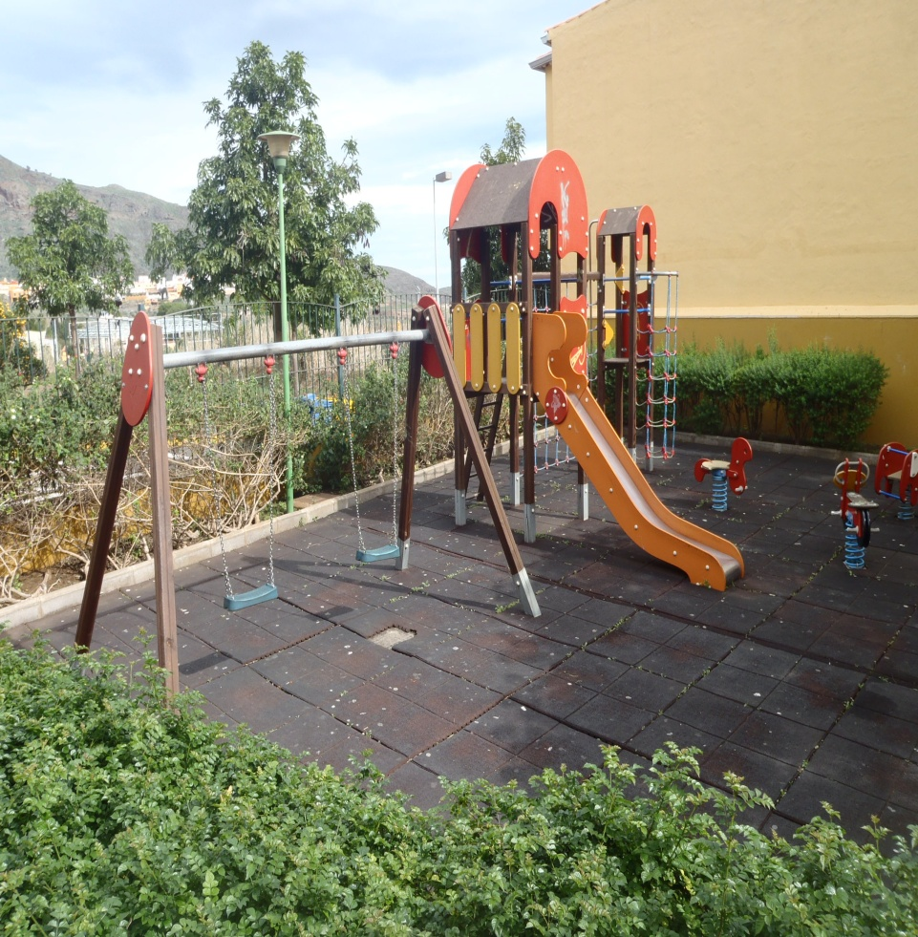
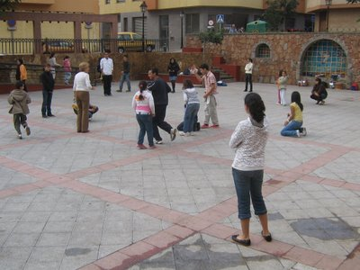
Our playgrounds!
These are our favorites places, when we were children, we played at the park and in the Tifariti square and now we go to the swimming pool, to the park to talk, or to the fields to play football or basketball.

Slide 6
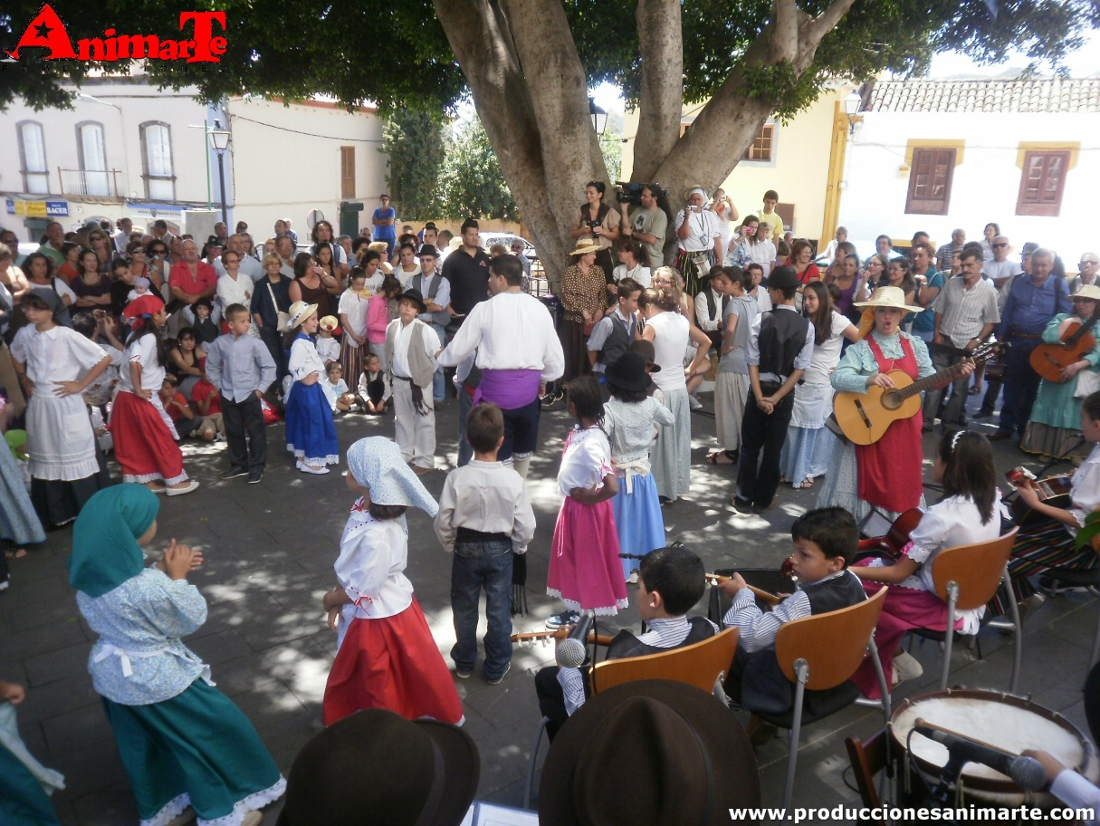
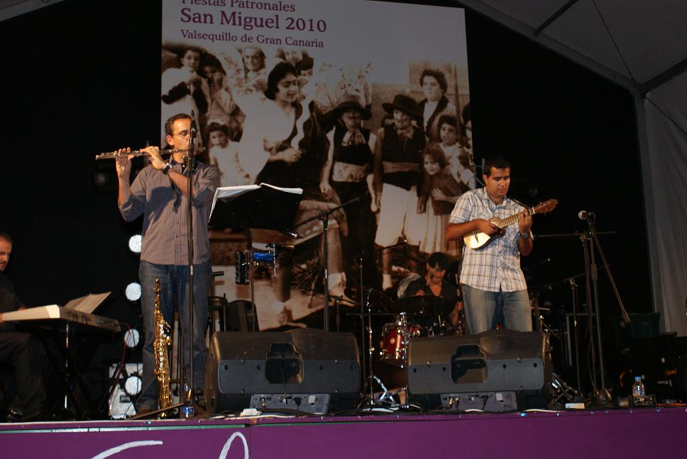
At our music school we learn to play the guitar, piano, violin, cello, saxophone … And many things more, we learn to paint, dance, sing…

Slide 7
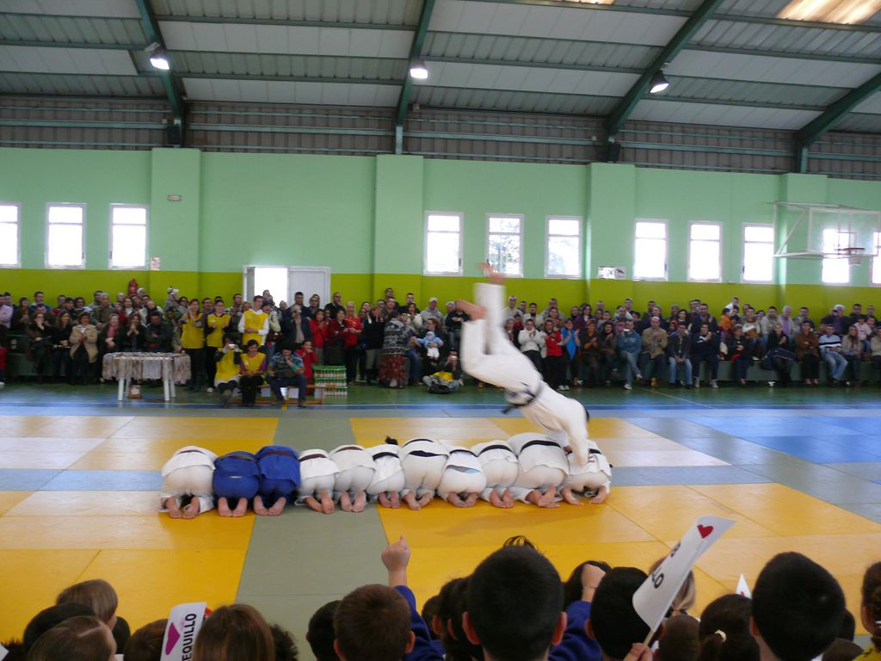
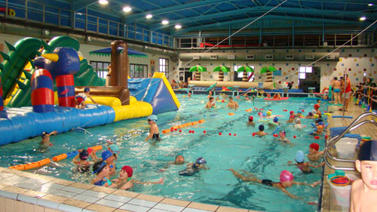
Sports
The sports we most practice are football, basketball and handball.
In these sports we win lots of awards. And you can also play tennis or padel; swim; or play judo

Slide 8
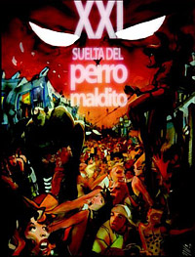
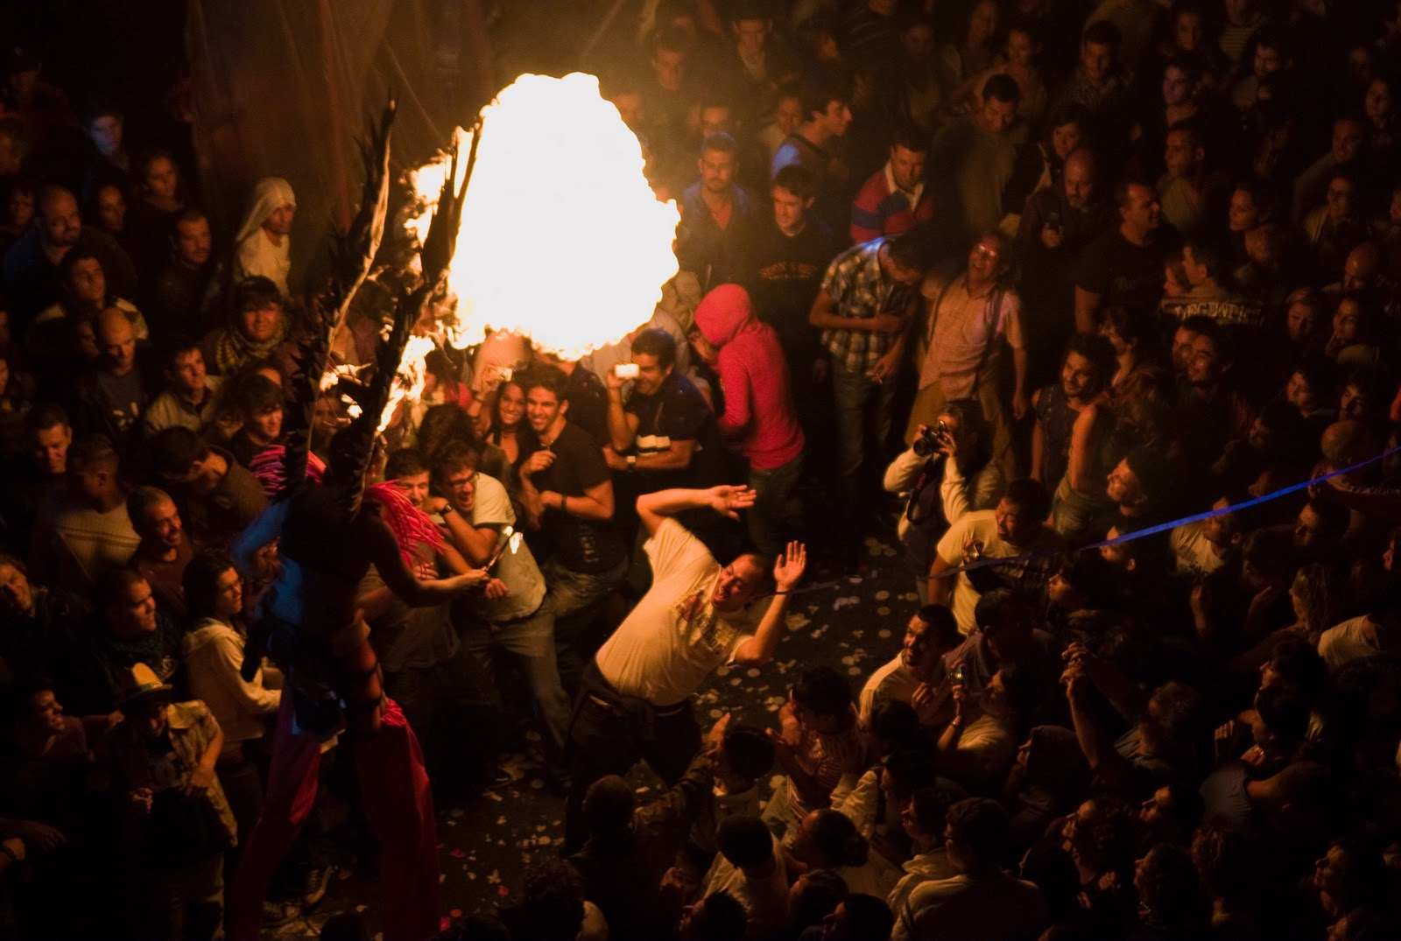
PERRO MALDITO!
“La Suelta del Perro Maldito” is the biggest holiday we have in Valsequillo. It is celebrated on the eve of San Miguel’s day.
San Miguel kills the devil.

Slide 9
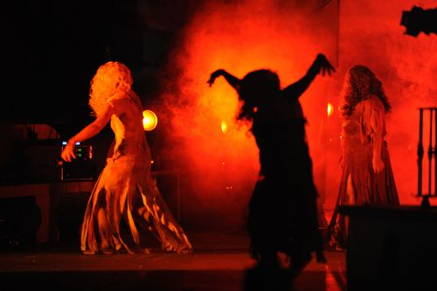
More than 10,000 people enjoy the show every year. The show begins when, at midnight, the lights are turned off and the music and the special effects start. The actors and the decoration are made by the people of our town.

Slide 10
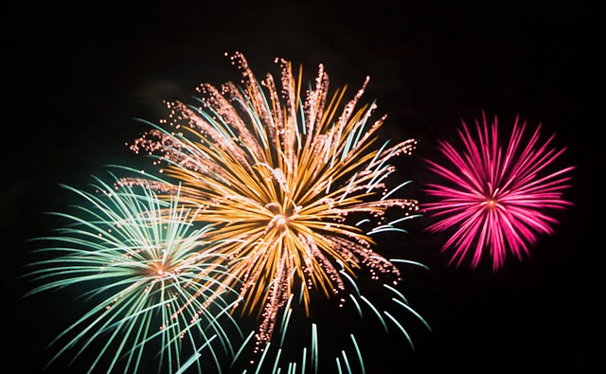
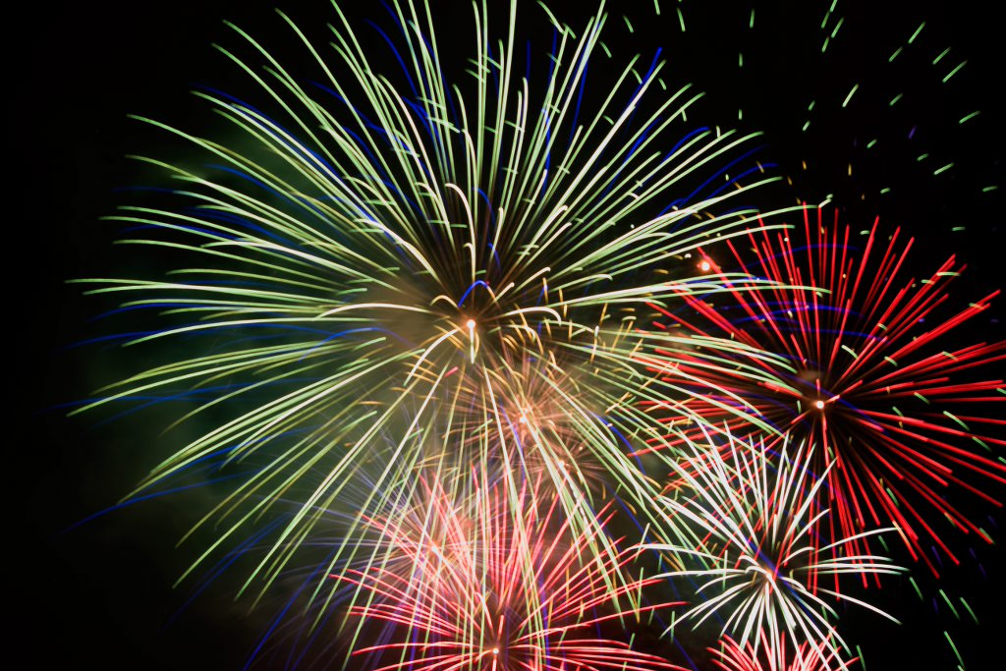
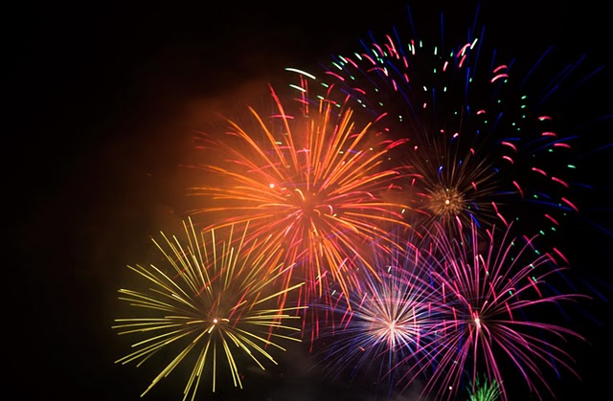
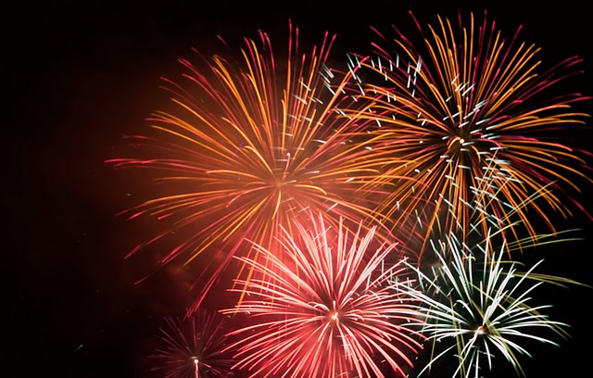
After the party, the fireworks begin and it is a very beautiful show. The fireworks are from our pyrotechnic San Miguel

Slide 11
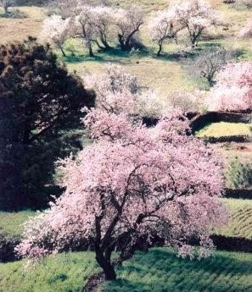
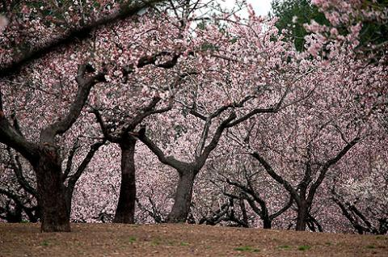
Every year we celebrate a party when the almond trees flourish. We dance and sing our typical dances, there are artisans who sell there goods, we go to the village and met with our friends.

Slide 12
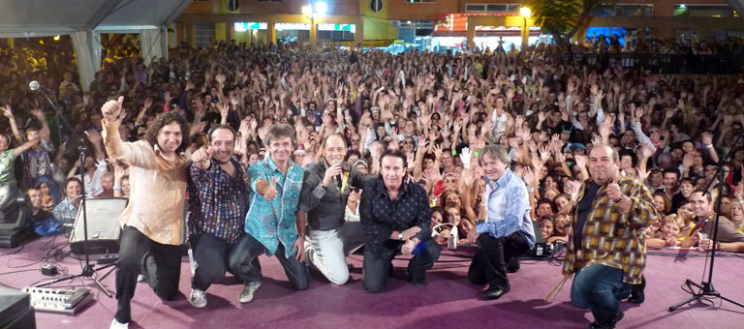
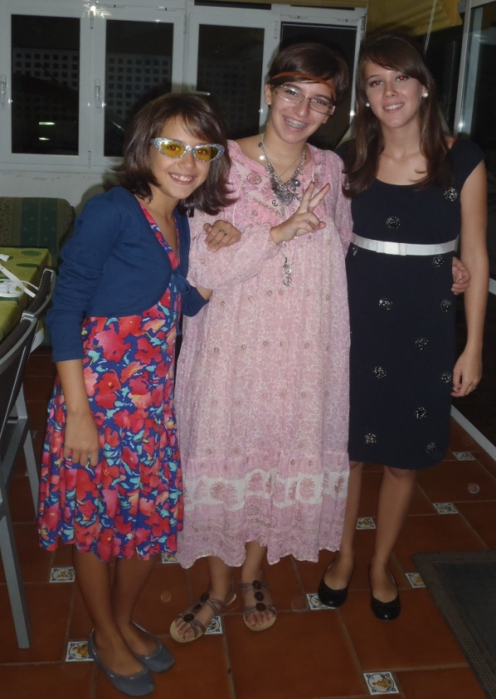
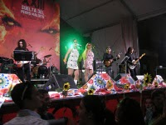
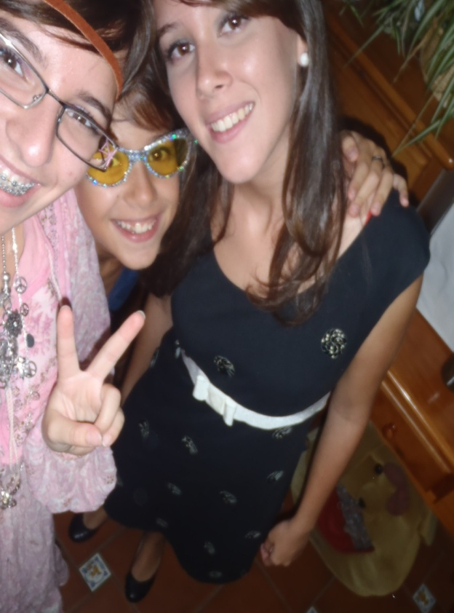
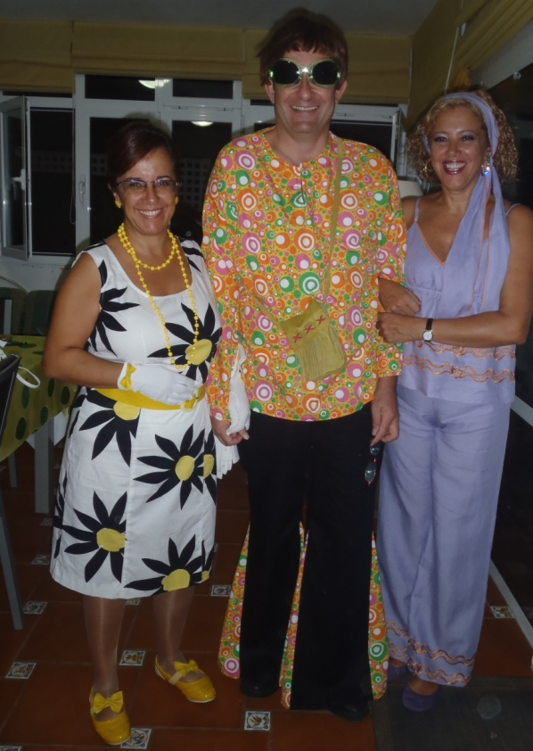
Party of the 60’s!
The party is celebrated every september. It's a party where everybody dress up with his sixties clothes and dances to music of the decade. Not only young people go, adults also go to this party. The adults do fashion shows to see who is best suited to the era dress

